Slide 1
Audience Analysis
Phillip G. Clampitt, Ph.D.

Slide 2

1. What is it?
The process of investigating the people you will be communicating with and their situation.
Process
  Before
  During
  After
Investigating
People & Situation

Slide 3
2. Why do we do it?
Anticipate audience responses
Know what to express
Know what to repress
Determine how to achieve our objectives
Ascertain likely level of effectiveness
ROT: Adjust your messages to the audience

Slide 4
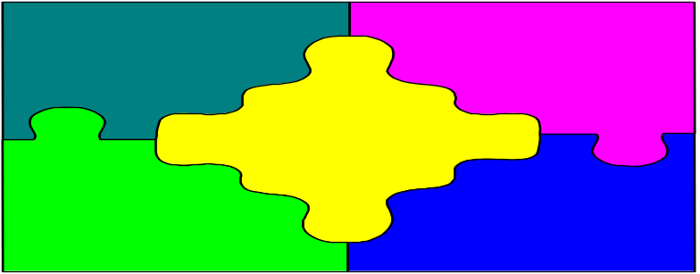
3. How can we define an audience?
Place (GB, Brown County, State)
People (age, gender, beliefs, edu., income ..)
Medium/channel (TV, radio ….)
Content (sailing, football fans, ….)
Time (prime-time, daytime ….)

Slide 5
4. So what?
Lots of ways to slice the pie, all of which may be valid.
People probably are members of various “pie slices”
Some pie slices are more important than others (relationships between slices)
The critical issue: determining which is the “best way” to slice it in a given situation

Slide 6

5. What do we need to know about the audience?
We can’t know everything
Salient issues
Critical relationships
Beliefs/Values
Demographics
Lions
Potential resistance points

Slide 7
6. How do we conduct AA?
Behavioral driven inferences (M-B)
  e.g. Refrains from talking = Introvert
Demographic driven inferences
  e.g. female = relationally oriented
  GB = Catholic oriented values
Surveys
Focus Groups

Slide 8

7. What is a survey?
A survey is a system for collecting information to describe, compare, or explain knowledge, attitudes, and behavior.
  Qualitative
  Quantitative
  Mixture

Slide 9
8. Characteristics of good surveys
Specific objectives
Straightforward questions
Sound research design
Sound choice of population/sample
Reliable & valid survey instruments
Appropriate analysis
Accurate reporting
Reasonable resources

Slide 10

9. Effective AA researchers
Ask appropriate questions
  e.g. “Did George W. Bush’s vague and scripted debate responses make favorable, unfavorable or no impression” (DNC)
  Concrete
  Conventional language
  Avoid loaded words & bias
  Balance responses on scale
  Avoid polarization
  Have been tested for misunderstandings (technical language)
Organize the survey appropriately
  Think about risk
  Visual appeal
  Easy to complete
  Instructions are clear

Slide 11
Effective researchers cont.
Use the right sampling techniques
  Confidentiality
  Provide incentive
  Distinguish between target pop. & sample
  Randomness
  Calculate response rate
Create reliable& valid instruments
  Reliability - consistent results
  Valid - accurate results

Slide 12
Effective researchers cont.
Analyze quantitative data appropriately
  Focus on the distribution (e.g. what does the mean mean?)
  Know what is statistically significant
  Use the appropriate statistical tests
Analyze qualitative data appropriately
  Create categories
  Test for reliability
  Test for validity

Slide 13
Effective researchers cont.
Report quantitative results clearly and accurately
  Use graphs
  Use tables
  Indicate sample nature
  Provide copy of survey (e.g. appendices)
Report qualitative results clearly and accurately
  Use charts (e.g Rank, Percent, Sample comments)
  Report reliability
  Provide copy of all responses

Slide 14

10. Focus groups
Def. - A research method designed to gather qualitative data through a focused discussion conducted by a trained moderator.
Research method
Qualitative data
Focused discussion

Slide 15

11. Planning Focus Groups
Planning
  Purpose
    Issue identification
    Survey development
    Detect issue salience
  Agenda
  Interview guide
    Introduction
    Questions
  Recording methods
  Survey
Recruiting
  Incentives
  Time
  Group size (6-15)

Slide 16
Planning cont.
Moderating
  Motivate
  Orient
  Probe
  Manage distractions
  Spark interaction
  Manage people problems
  Recording
Analyzing & Reporting
  Be systematic
  Discern themes
  Prioritize themes
  Report specific & representative comments

Slide 17
12. Crafting objectives
Decide on specific objectives for each group
  Issue oriented
  Conceptually oriented (e.g. distinguish between valued added and core services)
  Relational oriented
Decide on global objectives
Synthesize specific and global objectives

Slide 18

13. Crafting the messages
Pay close attention to the connotation and denotations of the words
Watch out for “hidden” polarity items
Focus on the motivating themes
Use the message to circumvent the resistance points.
Make sure messages fit with objectives

